Slide 1
Probability, Bayes Theorem, its applications and their applications
Yogesh Padmanaban

Slide 2
Set Language
Set is collection of well defined objects .
A Room has Adam (wt=60kg), Barbara(wt=50kg) , Njango(wt=70
Sample Space also called as Universal set .
Universal Set : All possible values of consideration in a setup ( S )
Set S = weight of people in a room = 60,50,70
Set A = weight of males in a room =60,70
A⌃ = S-A = 50 , weight of females in a room
Set B = A^ = 50 = S-A
Empty set = { }
Intersection A∩B = // common elements amongst A and B
Union A∪B= A+B- A∩B // a copy of all elements without duplicates
S
A
B
A∩B

Slide 3
Experiment , Output & Observation
Experiment : Rolling two dices
Output: 5 and 5 shows up on top of dices
Observation A: sum of numbers showing up = 10 (in this case )
Sample set or Universal Set S1 = all possible values in consideration in this setup
= 2 , … 12
Observation B : sum of numbers facing down ( depends upon dices )
Sample set or
Universal Set S2 = all possible values in consideration in this setup
= 2 , … 12
Observation C : sum of numbers facing up and down in two dices
Sample Set or
Universal Set = all possible values in consideration in this setup
= depends upon dices

Slide 4
Random Variable
Random Variable : A variable which can take a set of values ; or a set of
function of values or ; set of functions of random variable .
Random Variable taking set of values :
RV_{K} = wt of kindergarten kids in a room = 15, … ,45
RV_{HS}= wt of Higher Secondary in a room = 45, ..,,90
Random Variable taking set of functions of values :
RV_{Sum} = sum of wt of kindergarten kids in a room = 1000
RV^{j}_{Sum} = sum of wt of kindergarten kids in jth room = 1520
Random Variable taking set of functions of Random Variables
RV_{ratio} = ∑_{j} log (RV^{j}_{Sum} )

Slide 5
Events
An Event is defined as a Random Variable taking a value .
Random Variable RV_{A} = “ Today’s Weather in India “
Universal Set A = humid, rainy , windy , sunny
Random Variable RV_{B} =” having an umbrella “
Universal Set B = with umbrella , without umbrella
Event A is “ rainy day “ or
RV_{A} = “ rainy “
Event B is “ having an umbrella “
RV_{B} = “ with umbrella “

Slide 6
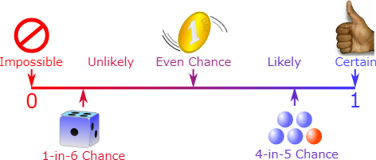
Probability, a measure of chance of an Event
Probability is a measure of chances of an Event. It is a real number from (0,1)
associated with an Event . 0 for an impossible event . It is 1 for a certain event .
Axioms of Probability :
* Probability value is in [0,1]
For instance :
Random Variable A taking values = a1,a2,a0
P(A=a1)=0.5; P(A=a2)=0.5; P(A=a0)=0.0;
P(A=a1) +P(A=a2) + P(A=a0) =1
* If values taken by Random Variable is discrete , it is called as probability mass Function ( pmf )
* If values taken by Random Variate is continuous , it is called as probability Density function ( pdf )
* Sum of all Probability for all possible events is 1 or ∑_{i} P_{i}= 1 (pmf) or ∫ P_{i} =1 (pdf)
* Point-wise Probability value : P(A=a1)
* Probability distribution:
P(A) is distribution of all possible point-wise values P( A = a_{i} ) by A in set S_{A}
Val | P(A=val)
a1 | 0.5
a2 | 0.5
a0 | 0.0

Slide 7
Probabilistic Space
Probabilistic Space is made of :
* A sample space 𝛀 which is set of all possible outcomes .
* A set of events ℱ where each event is a set containing zero or more outcomes.
* The assignment of probabilities to events .

Slide 8
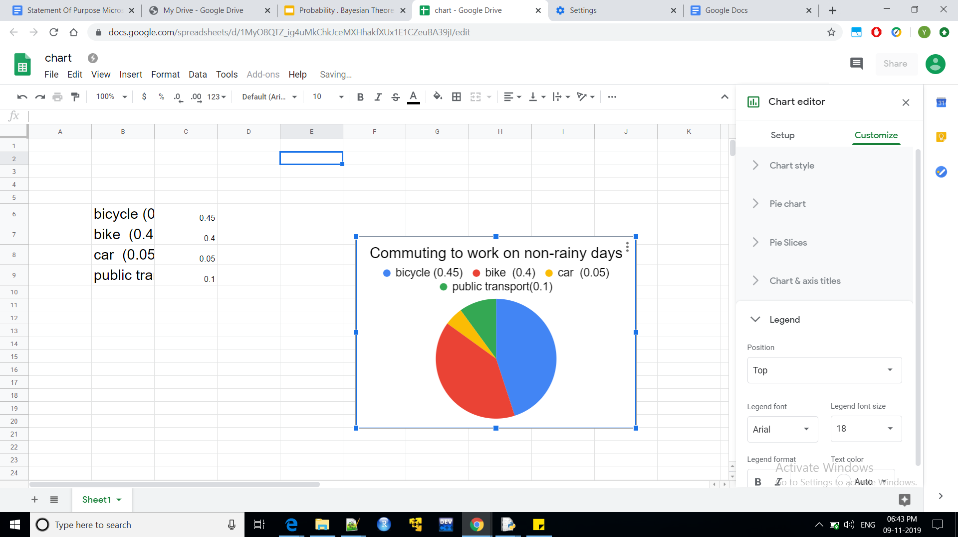
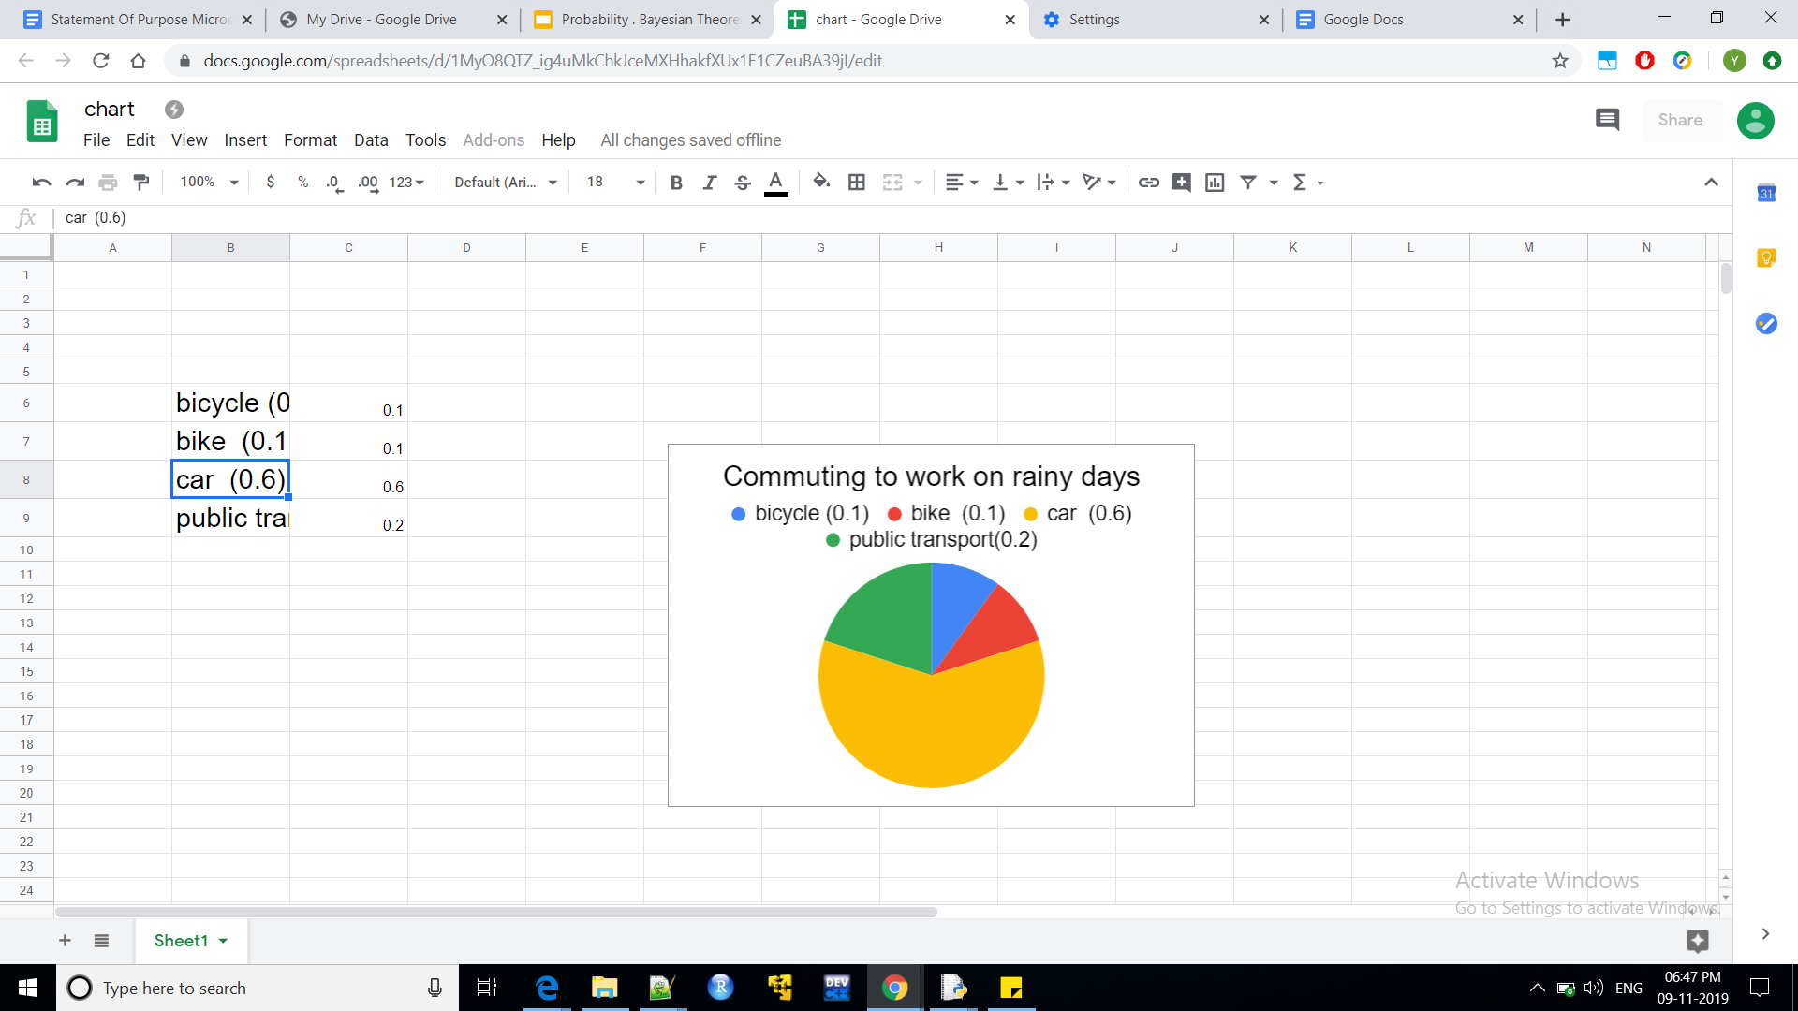
Visualising Probability
Random Variable A is “ commuting to work “
Values = ‘bicycle’ ,’bike’ ,’car’, ‘public transport ‘
On non-Rainy days :
P(A=’bicycle’) = 0.45
P(A=’bike’) = 0.4
P(A=’car’) = 0.05
P(A=’public transport’) = 0.1
On Rainy days :
P(A=’bicycle’) = 0.1
P(A=’bike’) = 0.1
P(A=’car’) = 0.6
P(A=’public transport’) = 0.2
Above collection of Probabilities of Random Variable
For all available values is called Probability
Distribution of A

Slide 9
Probability : axioms and Probability Distribution
* Union : P(AUB)= P(A) + P(B) + P(A∩B)
* Joint Probability (point wise)
P(A=a1,B=b1, C=c1 , ….) : The Probability of collection of Random Variables simultaneously taking values from their corresponding sets of applicable values.
* Joint Probability Distribution :
Tabulation of all possible combinations of all possible values of all
Random variables considered .
* Conditional Probability
P(A/B) = P(A∩B) / P(B) for any Events A,B
= P(A) for event A independent of B
*P(A∩B) = P(A/B)P(B) = P(B/A)P(A) for any Events A,B
= P(A)P(B) for event A independent of B

Slide 10
Joint Probability Distribution and Marginal Probability
Joint Probability Distribution : A probability distribution of more than 1 Random variables taking values simultanously.It comprising all possible combinations of random variables tak ing values amongst their individual or common uniserval set .
Sum of all individual probability is 1.
Marginal Probability : It is the Probability distribution of fewer random variables obtained from a Joint Probability distribution via aggregation /summation .
P(A,B) | P(A,B=b) | P(A,B=b0) | P(A)
P(A=a,B) | P(A=a,B=b) | P(A=a,B=b0) | ∑_{B} P(A=a,B)
P(A=a0,B) | P(A=a0,B=b) | P(A=a0,B=b0) | ∑_{B} P(A=a0,B)
P(B) | …. | …. | ….
Marginal Probability

Slide 11
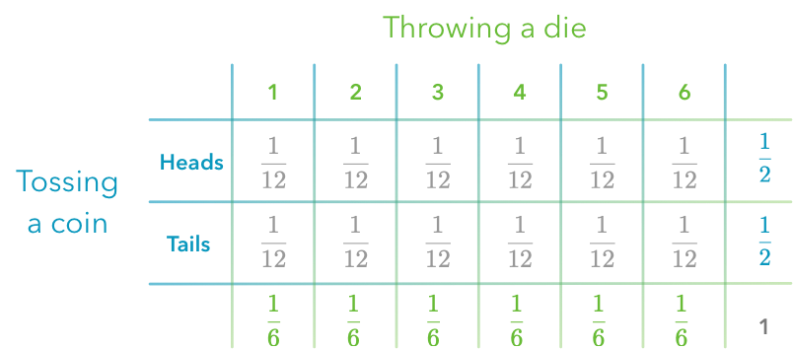
Joint Probability distribution and Marginal Probability
Random Variables
Th =: throwing a dice
C=: coin tossing
Joint Probability distribution, P(Th,C)
Marginal Probability
P(C=j)
Marginal Probability
P(Th=i)
Total Probability
∑_{i} P_{i} =1

Slide 12
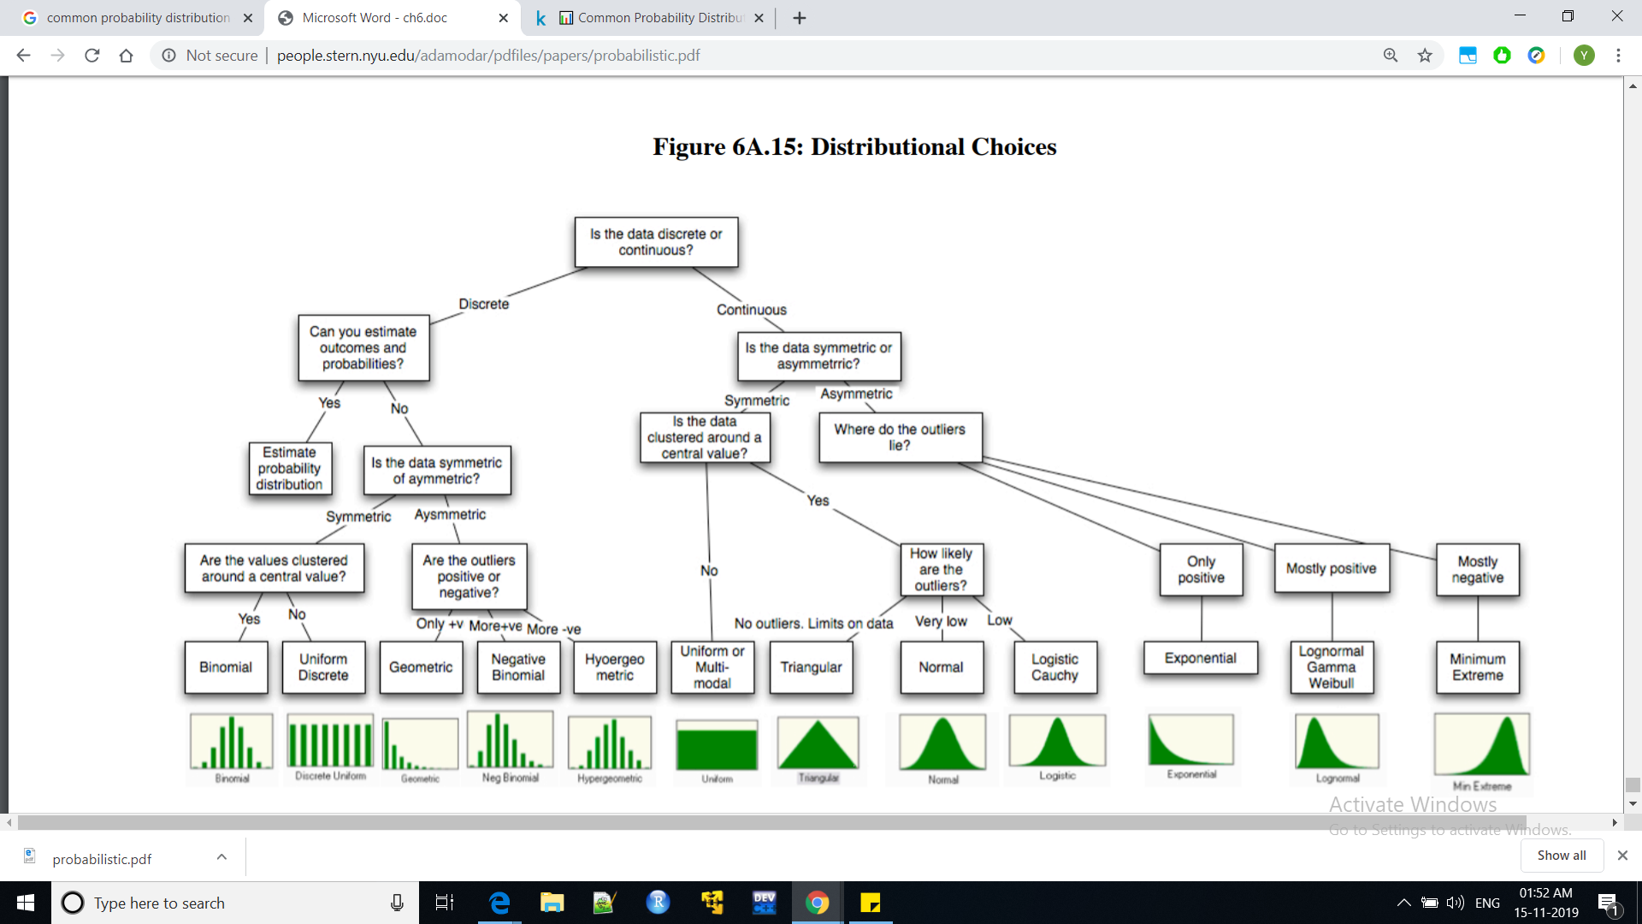
Commonly used Probability Distribution choices

Slide 13
Probability of Events with notification / evidence
* The Probability of taking an umbrella given that siri said ‘ it might rain today ‘
* The Probability of a noisy colony ( with kids ) on a notification of a public ‘bandh and no school ‘
* The Probability of fishing boats sailing on sea where there is Tsunami warning from coast guard
What will the probability of above events if there was no notifications ?

Slide 14
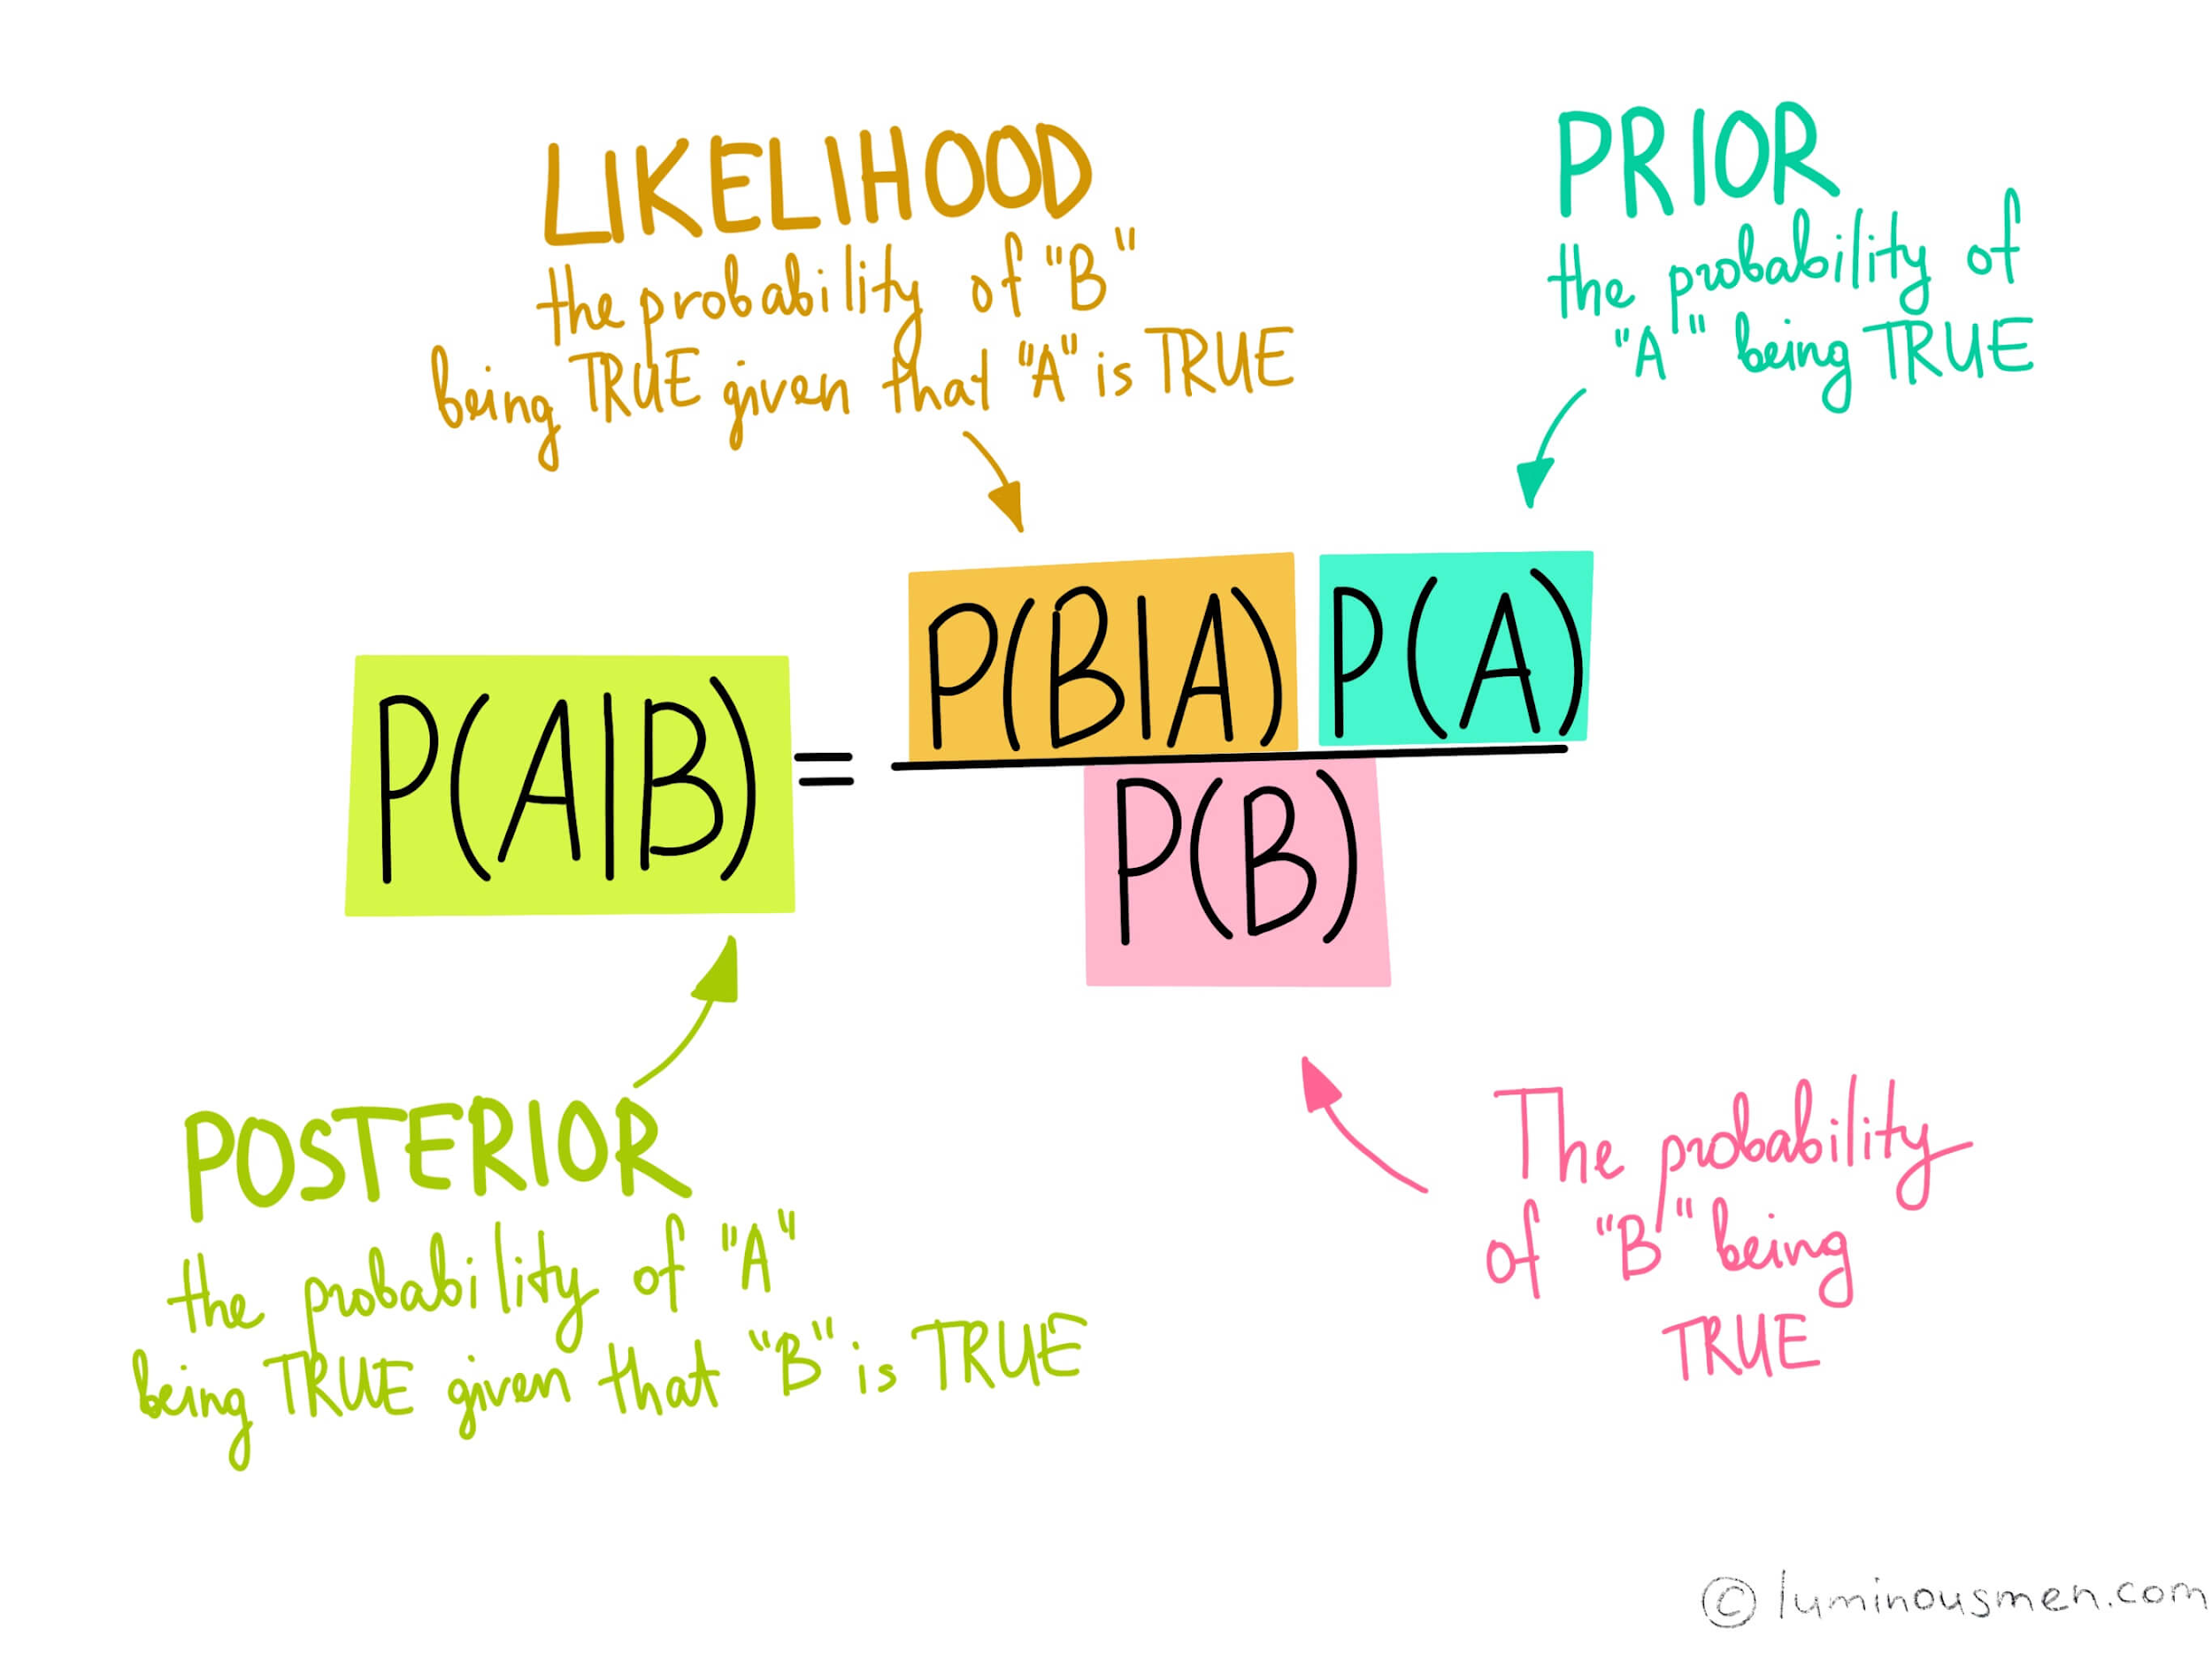
Bayes Theorem
A and B are Events . According to Bayes Theorem for Events A and B. A is similar to notification .

Slide 15
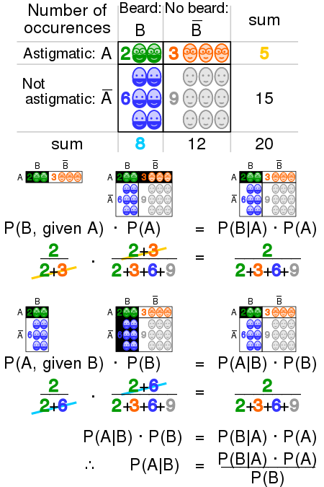
Bayes Theorem,
A Visualisation

Slide 16
Probability of Events (likelihood) with notification (prior)
* The Probability of taking an umbrella ( likelihood ) given that siri said ‘ it might rain today ‘ . Here notification (prior) isnt a certainty but probabilistic .
* The Probability of a noisy colony with kids (likelihood) on a notification of a public ‘bandh’ and no school‘ . (prior)
* The Probability of fishing boats sailing on sea (likelihood) where there is tsunami warning from coast gaurd (prior)

Slide 17
Posterior , prior and likelihood
* What is the Probability of siri saying ‘it might rain’ if an Umbrella has been picked
up? It is called Posterior probability .

Slide 18
Probability vs trials
If probability of a Tails at a coin is 0.5 , will 5 out of 10 toss of that coin be definitely Tails ?
How to identify loaded dice ?
How many trials required for the first Tails of a coin ?
(Geometric Distribution)
Probability is measure of chances on a long term relationship between the values rather than a short term / immediate result.
But still, Confidence intervals can be obtained on how balanced a dice is after several trials with thresholds

Slide 19
Conditioning an Event on an Event
Conditional Probability: It is a measure of the probability of an event occurring
given that another event has occurred .
Independence of an Event A on another Event B : If Event A’s occurence isnt
affected by presence or absence of an Event B or vice-versa then events A and B
are independent . ( A ⊥ B )
P(A ∩ B) = P(A) P(B) for A ⊥ B
Events A is independent of B
Conditioning of Event A on event B: If event A’s occurence is affected by presence
or absence of event B or vice-versa , then events A and B arent independent.
P(A/B) = P(A∩B) if A isn’t independent of B
P(B)
P(A/B) = P(A)P(B) = P(A) If A is independent of B
P(B)
∩∩

Slide 20
Conditional Independent events
conditional probability is a measure of the probability of an event occurring given that another event has (by assumption, presumption, assertion or evidence) occurred .
Two random events A and B are conditionally independent given a third event C if the occurrence of A and the occurrence of B are independent events in their conditional probability distribution given C.
P( A,B|C) =P(A|C) * P(B|C) => ( A ⫫ B ) |C
In other words, A and B are conditionally independent given C if and only if, given knowledge that C occurs,
knowledge of whether A occurs provides no information on the likelihood of B occurring, and
knowledge of whether B occurs provides no information on the likelihood of A occurring.

Slide 21
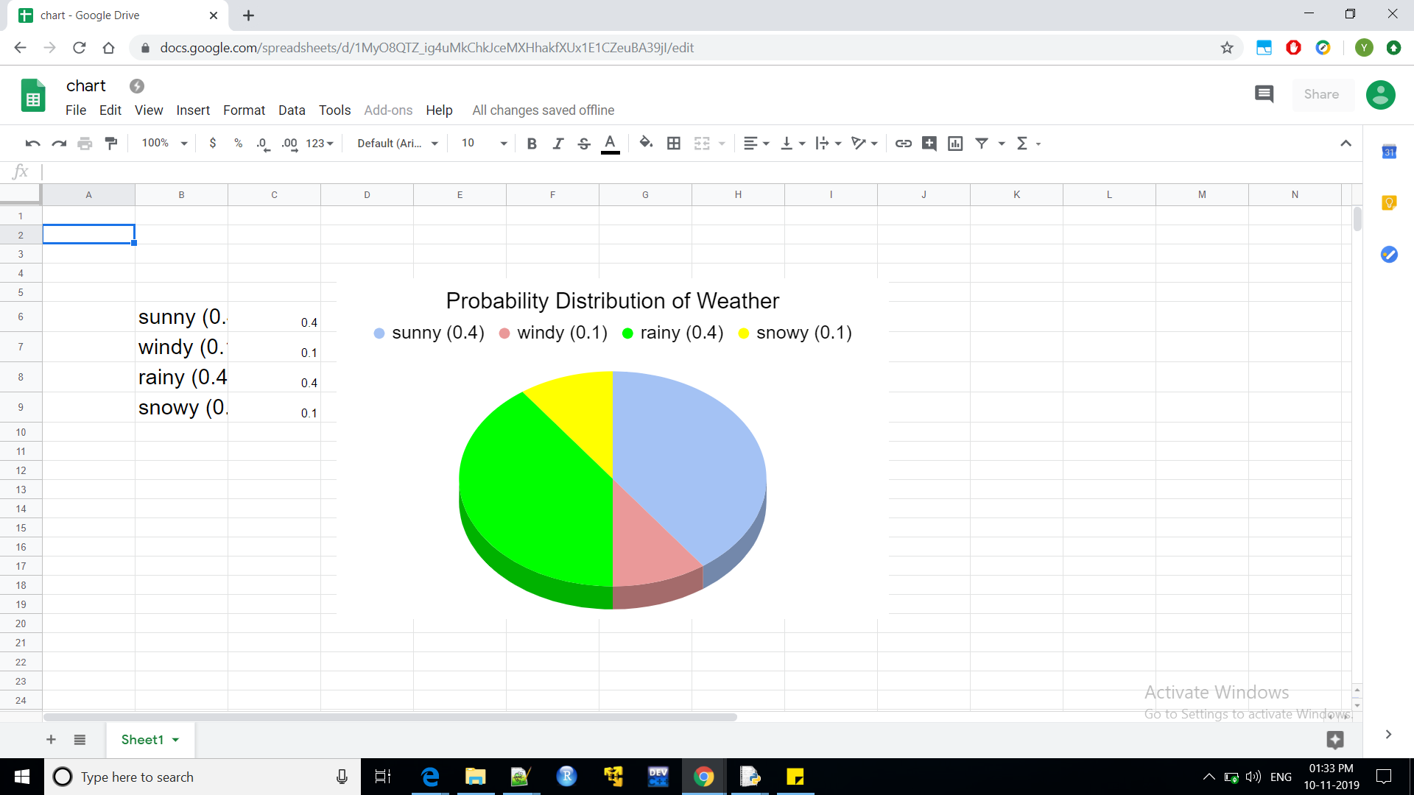
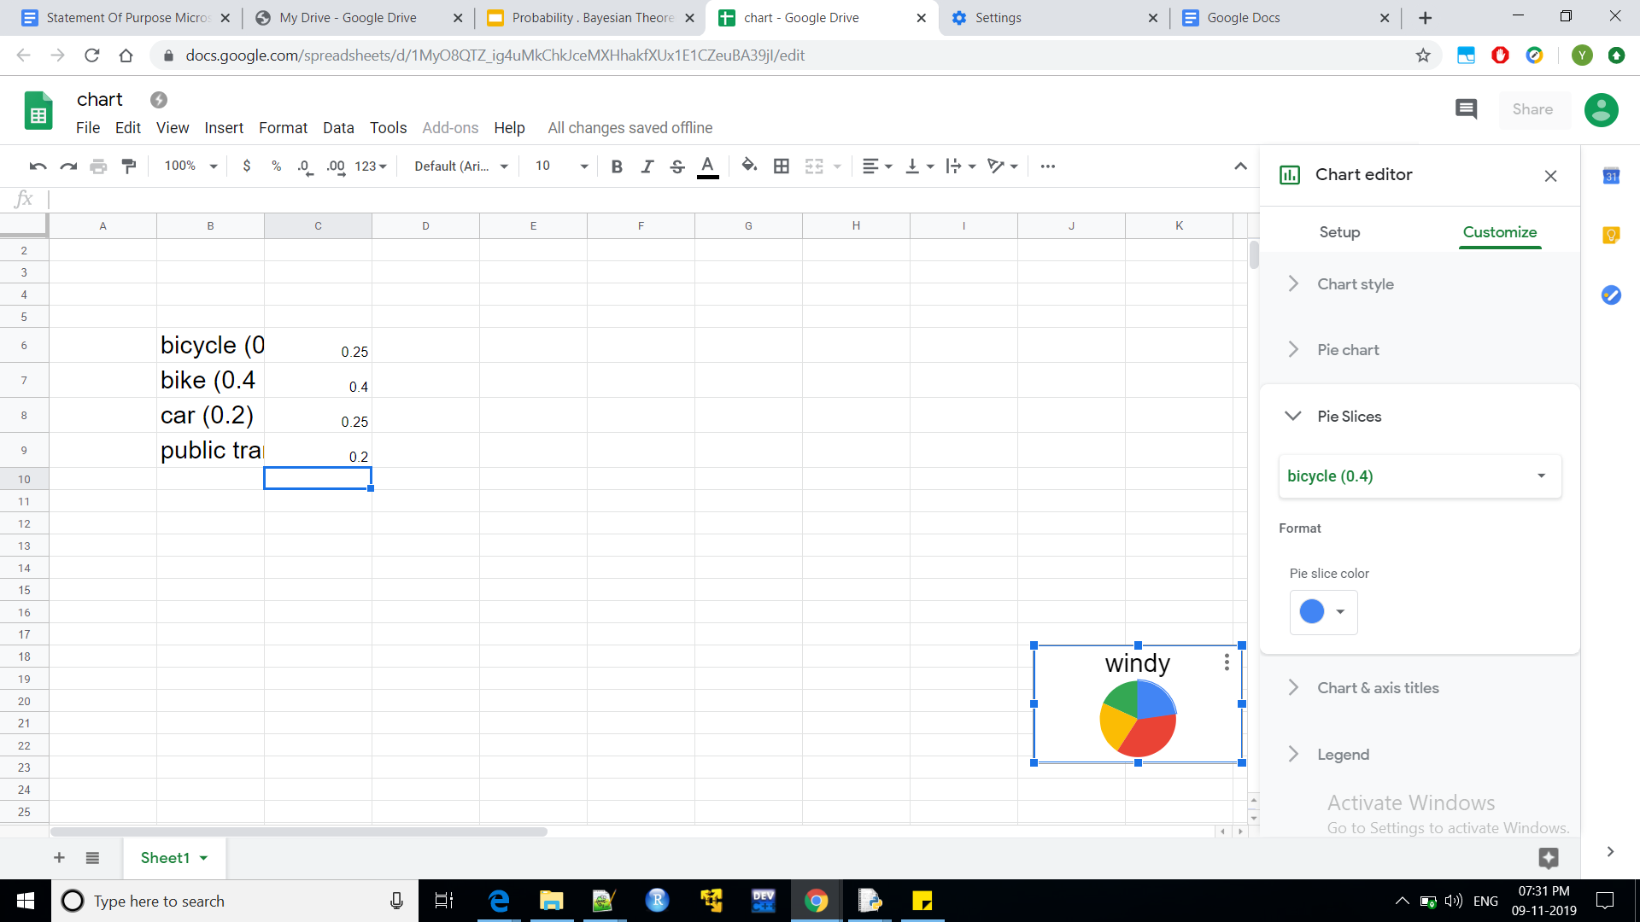
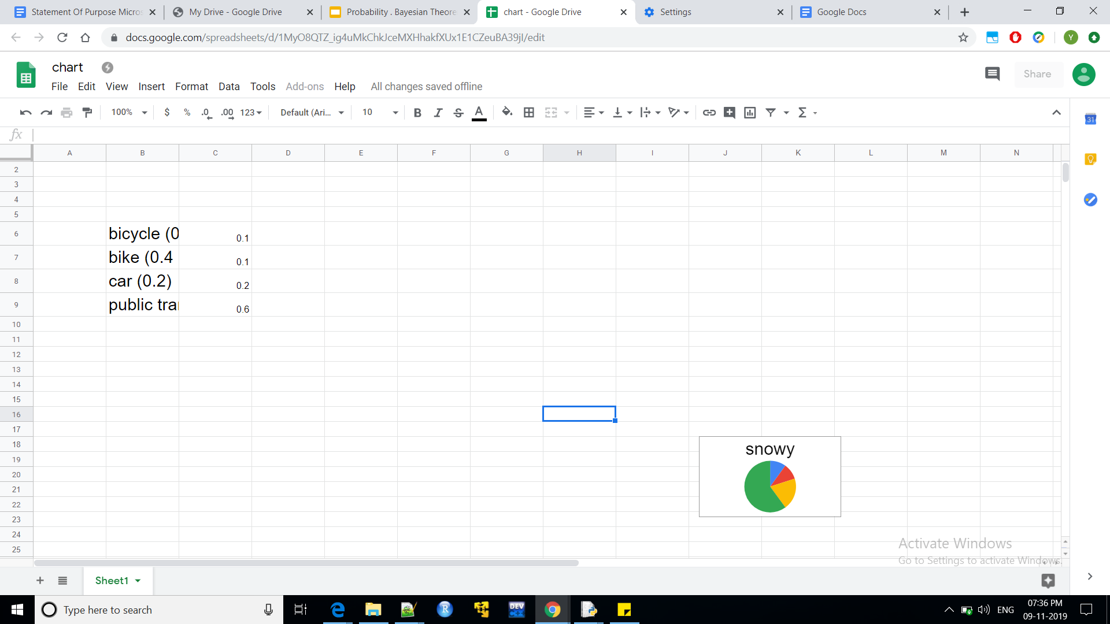
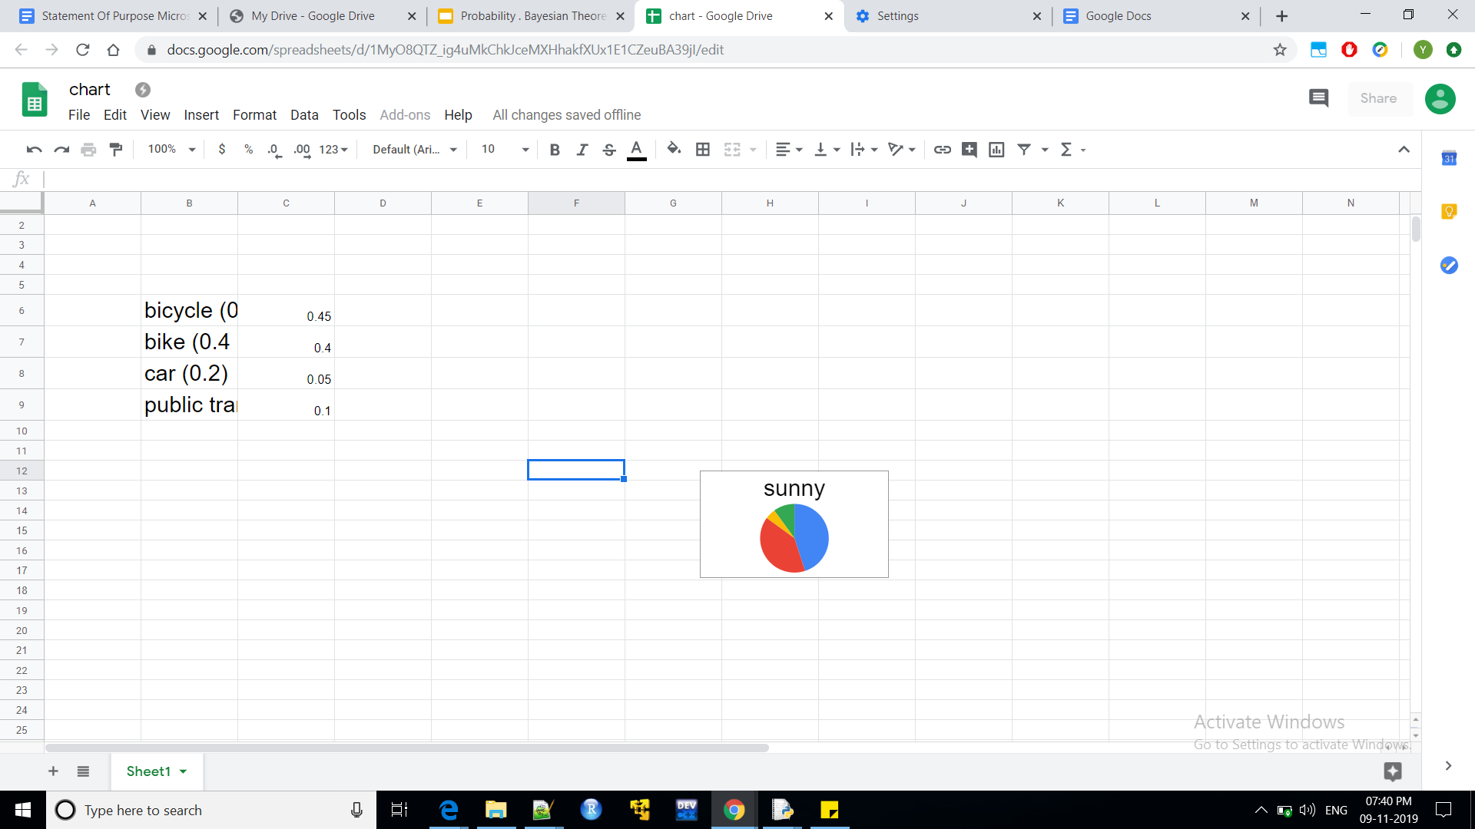
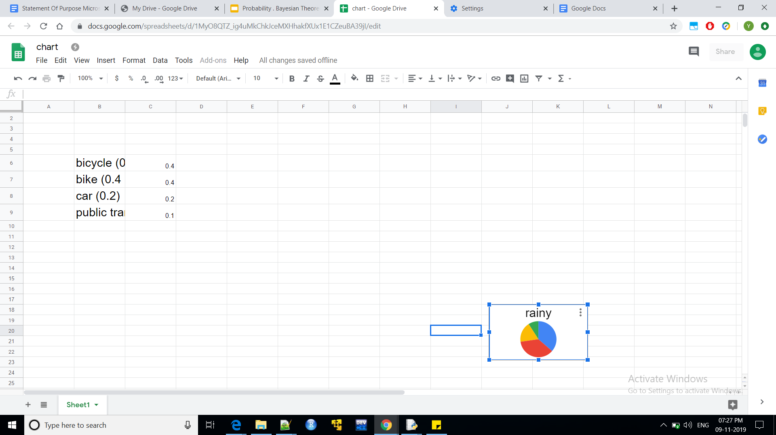
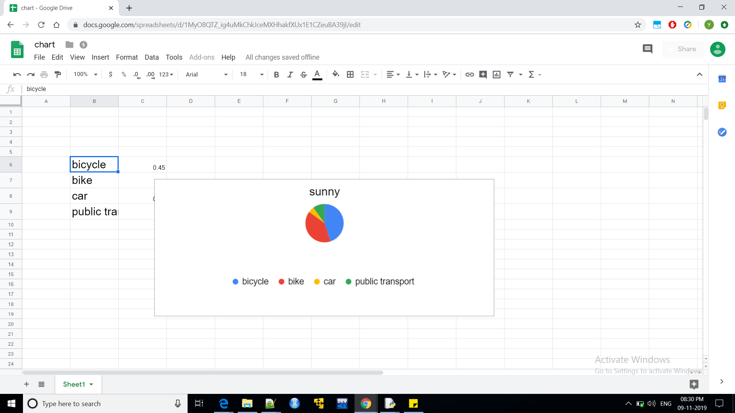
Visualising Conditioning of Events
Random variable A = ‘ today’s Weather ‘
Universal set S_{w}= sunny, rainy,windy,snowy
Random variable B = ‘ today’s Commute ‘
Universal set S_{C}= bicycle,bike,car,public transport
Probability Distributions of various commuting on various Weather

Slide 22
Probability Distribution of Commuting (2D circle) on Probability distribution of Weather (pizza)

Slide 23
Dependent and Independent Random Variables
* An independent random variable is a random variable that doesn't have
an effect on the other random variables in your experiment.
In other words, it doesn't affect the probability of another event happening.
* ‘ If Random variable A’s Probability Distribution is affected by presence or
absence of another Random variable B taking any of the values of universal set
S_{B} Or vice versa “ , then A and B are dependent on each other.
* ‘ If Random variable A’s Probability Distribution isnt affected by presence or
absence of another Random variable B taking any of the values of universal set
S_{B} or vice - versa ‘, then Random Variables A and B are independent .

Slide 24
Bayes Theorem for multiple variables
For an dependent variable A and a set of independent variables
B B₀ ,B₁, …. B_{k} , … B_{n} , Bayes Theorem states that :
P(A,B₀,B₁, … B_{k} , … B_{n})
= P(A) P(B_{n}, … ,B_{k}, .. B₁,B₀/ A) applying Bayes Theorem
= P(A) P(B_{n}/A) P(B_{n-1} , … , B_{k} , … B₁,B₀/A,B_{n}) applying Bayes Theorem
= P(A) P(B_{n}/A) P(B_{n-1}/A,B_{n}) P(B_{n-2},...,B_{k}, … , B₁ , B₀/A,B_{n},B_{n-1})
This is a generic formulation of a joint Probability function as We aren’t aware of conditional dependency amongst the Random Variables . What if we are aware of conditional dependency amongst them ? we can build a Bayesian Network

Slide 25
Naive Bayes Classifier
If all of the feature variables are assumed to be mutually independent amongst each
other conditioned on target variable “Target” , it is called as naive bayes assumption.
P( f_{i} | f_{i+1} , f_{i+2} ,...., f_{n ,} Target ) = P( f_{i} | Target )
From Joint Probability
P(A,B₀,B₁, ….B_{n}) = P(A) P(B_{n}/A) P(B_{n-1}/A,B_{n}) P(B_{n-2},...., B₁ , B₀/A,B_{n},B_{n-1})
P(Target , f₀, f₁ , f₂, …. f_{n} )
= P(Target) * P(f₀,f₁, ….f_{n}| Target ) (using Joint Probability )
= P(Target) * P(f₀|f₁,f₂, …. f_{n},Target) * P(f₁,f₂,....,f_{n}|Target )
= P(Target ) * P(f₀|Target) * P( f₁,| f₂, …. , f_{n},Target) (using naive Bayes assumption)
….
= P(Target) * P(f₀|Target) * P( f₁|Target ) , …. , P (f_{n}|Target)
Naive Bayes is faster for implementation can be a baseline for other classifiers .

Slide 26
Naive Bayes Classifier (continuing )
From Conditional Probability
P(Target | f₀,f₁, …. ,f_{n} )
= P(Target , f₀ , f₁, …. ,f_{n}) / P( Target )
(From last equation )
= P( Target ) * P (f₀|Target ) * P( f₁| Target ) * …. * P ( f_{n} | Target ) / P (Target)
= P(f₀ | Target ) * P ( f₁ |Target ) * …. * P (f_{n} |Target)
Naive Bayes Classifier is fast to implement and can be a baseline for other classifier .

Slide 27
Bayesian Network
Bayesian Network is a DAG(Directed acyclic graph) of nodes and edges . Nodes representing random variables and edges representing conditional dependency amongst them .
It is also used for representing causality .
According to this BN ,
P(A,B,C,D,F,G,H,I,J)
= P(A) * P(B|A) * P(C|A) * P(D|A,C)* P(H|C)
*P(F) * P(G|H,C,B,F) * P(I|G) * P(J|D,H,G)
Conditionaly Independent Vars : A , F
Dependent Vars : B,C,G,H,I,D,J
F
I
B
G
A
C
H
J
D

Slide 28
Bayesian Networks Inference
* To Fully represent the joint probability distribution, it is necessary to specify for each node X the probability distribution for X conditional upon X's parents. The distribution of X conditional upon its parents may have any form
* Exact Inference from BN using variable elimination is “NP-HARD” .
* Approximate inference algorithms:
importance sampling (reducing variance )
stochastic MCMC(Markov Chain Monte Carlo) simulation (avoids local minima ; Gibbs Sampling)
belief propagation ( sum product Algorithm with O(n^2) Ops )
variational methods (variational Bayes)
* Param Learning : Expectation Maximisation is an approach to maximise likelihood or posterior
probability alternating between computing Expectation and maximisation in an iteration .

Slide 29
Bayesian Network Inference - Variable Elimination
* It eliminates (by integration or summation) the non-observed non-query variables one by one
by distributing the sum over the product;
* This method have complexity that is exponential in the network's treewidth.
* According to this BN ,
Computing for P(A) and P(F) and eliminating conditionally
Independent variables.
P(A,B,C,D,F,G,H,I,J)
= P(A) * P(B|A) * P(C|A) * P(D|A,C)* P(H|C)
*P(F) * P(G|H,C,B,F) * P(I|G) * P(J|D,H,G)
Conditionally Independent Vars : A , F,B,C
Dependent Vars : G,H,I,D,J
F
I
B
G
A
C
H
J
D

Slide 30
Bayesian Network Inference - Variable Elimination
Computing P(B|A) , P(C|A) , and eliminating conditionally independent variables .
According to this BN ,
P(A,B,C,D,F,G,H,I,J)
= P(A) * P(B|A) * P(C|A) * P(D|A,C)* P(H|C)
* P(F) * P(G|H,C,B,F) * P(I|G) * P(J|D,H,G)
Conditionally Independent Vars : A , F ,B,D,C,H
Dependent Vars : G,I,J
F
I
B
G
A
C
H
J
D

Slide 31
Bayesian Network Variable Elimination
Computing for P(D|A,C) , P(H|C) and eliminating conditionally independent variables
According to this BN ,
P(A,B,C,D,F,G,H,I,J)
= P(A) * P(B|A) * P(C|A) * P(D|A,C)* P(H|C)
*P(F) * P(G|H,C,B,F) * P(I|G) * P(J|D,H,G)
Conditionally Independent Vars : A , F , C,H,D,B, G
Dependent Vars : I,J
F
I
B
G
A
C
H
J
D

Slide 32
Bayesian Network Inference - Variable Elimination
Computing P(I|G) and P(J|D,H,G) for inferring I and J
According to this BN ,
P(A,B,C,D,F,G,H,I,J)
= P(A) * P(B|A) * P(C|A) * P(D|A,C)* P(H|C)
*P(F) * P(G|H,C,B,F) * P(I|G) * P(J|D,H,G)
conditionally Independent Vars : A , F ,B , C, G ,H , I , D , J
Dependent Vars :
F
I
B
G
C
A
H
J
D

Slide 33
Markov Blanket
It is the collection of nodes around a given Random Variable which is sufficing to explain the given Random Variable.
Only the distribution of these variables are needed to find probability distribution of the random variable in a bayesian network.
Parent, siblings and child nodes of given Node collectively called as Markov Blanket.
For Random Variable C, Markov Blanket is
{ A, B, F, H, G, D }
F
I
B
G
A
C
H
D
J

Slide 34
Bayesian Network Inference - Importance Sampling
*Importance sampling is a variance reduction technique that can be used in the Monte Carlo method.
*The idea behind importance sampling is that certain values of the input random variables in a simulation have more impact on the parameter being estimated than others.
*If these "important" values are emphasized by sampling more frequently, then the estimator variance can be reduced.
*Hence, the basic methodology in importance sampling is to choose a distribution which "encourages" the important values.

Slide 35
Markov Chain Monte Carlo ( MCMC )
* It is a sampling method which characterize a distribution without knowing all of the distribution’s mathematical
properties by randomly sampling values from a sequential process ( Markov Chain ) values out of the distribution
* By constructing a Markov chain that has the desired distribution as its equilibrium distribution, one can obtain a sample of
the desired distribution by recording states from the chain.
* The more steps that are included, the more closely the distribution of the sample matches the actual desired distribution.
* Various algorithms exist for constructing the Markov chain including the Metropolis–Hastings algorithm.
* Each random sample is used as a stepping stone to generate the next random sample (hence the chain). It is usually
followed when obtaining properties from Distribution’s equation is hard.
* it can be used to draw samples from distributions even when all that is known about the distribution is how to calculate
the density for different samples.
* Monte–Carlo is the practice of estimating the properties of a distribution by examining random samples from the
distribution.
* It is sequential and hard to parallelize ( Gibbs Sampling is hard to distributably compute )

Slide 36
Sequential Bayesian Network - Markov Model
In a sequence of events , if probability of an event is dependent only upon
previous events occuring, it is following a markovian model. If an event is only
dependent upon previous K events, it is called as Kth Order Markovian model .
For first order Markovian model of a sequence (A_{t0} , A_{t1 ,} A_{t2 , …..} A_{tn} ) :
* P(A _{t}| A_{t0},A_{t1},A_{,t2}, …. , A_{t-1},....) = P(A_{t} |A _{t-1})
* For instance Game of LUDO is coin moving based on previous 1 step and roll
of dice. It is a first order Markov Model.
* kid climbing stairs is another instance of markov model of first order.
Consequent step is based on previous 1 step and jumping up ( kid ) .
4

Slide 37
Nth Order Markov Model
Natural Languages are of nth-order Markovian
* The PC on hall of 10th floor of palace in london had crashed.
It is a higher Order Markov Model .
NLP is little tricky as it could be of high order
dependence in context . This higher order interaction amongst Random Variables
summons a n-lookbacks . LSTM/GRU are typically used to model NLP , as
Avoiding many layers of NN for damping vanishing gradient descent .

Slide 38
Latent variables , Hidden variables and confounding variable
Suddenly
His is polite .
His words are soothing
He chuckles like a child
He is nice to anybody .
What happened ? He became a Dad !
Hidden variable , or Latent variable are modelled to

Slide 39
HMM ( Hidden Markov Model ) a visualisation
For instance taking 12 dices for a 6 node HMM
Hidden States : (p,q,r,s,t,u)
Observation : (1 …. 6)
Hidden State Transition
(Probability of transition to / from a Hidden state )
1 …. 6
1 …. 6
5
4
q
r
1 …. 6
1 …. 6
6
p
1
p
State transition
based on Previous state
s
Observation state transition
( Probability of an Observation
in a hidden state )
1….6
1….6
u
6
1
t
2

Slide 40
HMM ( Hidden Markov Model ) an Example
For instance taking 12 dices for a 6 node HMM
Hidden States :
(sunny,rainy,cloudy,windy)
Observation:
(Temperature in ‘C )
Hidden State Transition
(Probability of transition to / from a Hidden state )
0’C to 45’C
0’ C to 45’C
29’C
14’C
sunny
rainy
Hidden state transition based on previous state
sunny
Cloudy
Observation avg temperature
( Probability of an Observation
in a hidden state )
windy
17’C
20’C
17’C
0’C to 45’C
0’C to 45’C

Slide 41
HMM Vitterbi Algorithm
* Obtain a most probable sequence.
* Obtain transition Probability matrix amongst hidden states and emission Probability matrix given a bunch of sequences.
* Obtain Marginal Probability of independent random variable.

Slide 42
Topic Modelling
* Latent Symantic Indexing(LSI)
* Latent Symantic Analysis (LSA)
* Probabilistic Latent Symantic Analysis(PLSA)
* Latent Dirichlet Allocation (LDA)

Slide 43
Latent Dirichlet Allocation
Latent Dirichlet Allocation is a Topic Modelling technique for Document Clustering
It uses Dirichlet Distribution ( generalisation of multinomial distribution) as a prior.
It follows Numerical methods iteratively for estimation of :
1. Probability of Topic to Doc match using a 2D array of floats for topics vs Docs.
2. Probability of word to Topic match using a 2D array of floats for words to Topics.
Iteratively the Probability values of these two matrices are updated and matured
through optimisation using following till convergence :
* Gibbs Sampling (sequential , slow , asymptotically accurate )
* Expectation Maximization (partially distributable and faster, accurate)
* Online Variational Bayes ( fast and approximately )

Slide 44
Practical LDA (python / pyspark) & number of Iterations
Two matrices Topic to Doc and Word to Topic provides the Probability of matching for Topic to Doc and Word to Topic respectively.
.As number of docs increases matrix Topics to Doc increases .
As number of Topics increases , both matrices size increases .
As vocabulary increases in corpus , matrix Word to Topic increases.
An iteration: Sampling via Gibbs Sampling or Expectation Maximization or Online Variational Bayes samples a part of corpus and updates a part of matrices and other parts remain as before .

Slide 45
Expectation Maximisation
It is a technique for optimising a function with parameters.
Initial parameters of an objective function are initialized with random values or priors ( dirichlet or gaussian or a sampling output ) .
After initialisation , an iteration consists of two following steps .
Computing Expected value of a Function with right set of parameters
Computing Maximising of function to obtain right set of params with earlier values as initial .
Till saturation or convergence or a deadline of the project or a consummation of a need of computational resource , number of iterations is increased .

Slide 46
Practical LDA and Number Of Iterations
So If number of iterations is increased , more parts of matrices are updated probabilistically. The probability of most of matrices maturing is higher.
For same number of iterations, the probability of match will slide as number of topics is increased / or vocabulary is increased.
Thus, the number of iterations must be proportional to vocabulary of corpus , number of docs and number of topics.
K ∝ T*D*V
T-> Num of Topics D -> Num of Docs
V- > vocabulary of Corpus K -> num of Iterations

